Slide 1
Manual for microsite of Ministry of Education

Slide 2
Home Page
LINK: https://naccaproject.gdatatalk.com

Slide 3
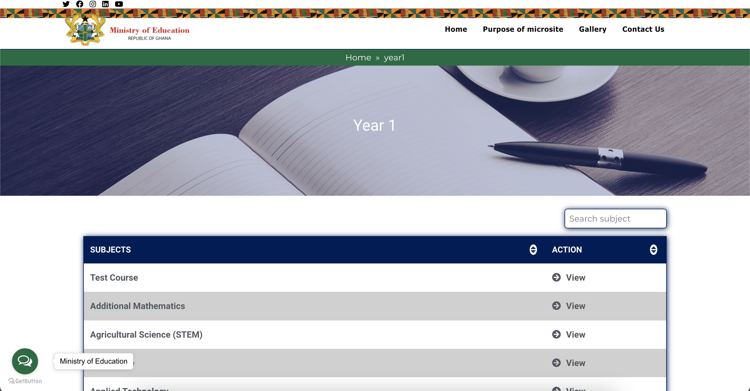
Learners Page
`
Click on the Learners link.
Click on the year.
See All Courses

Slide 4
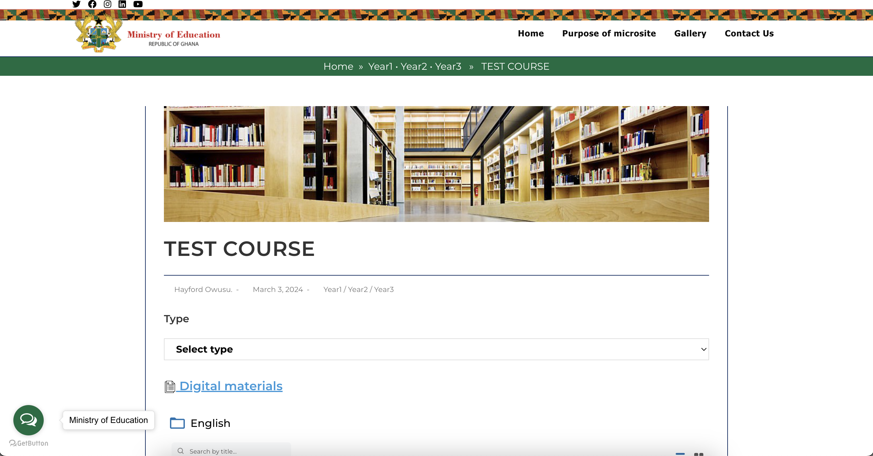
Courses Page - Learners
`
Click on the View link beside the course.
See Courses Page

Slide 5
Teachers Page
`
Click on the Teachers link.
Click on the year.
See All Courses

Slide 6
Courses Page - Teachers
`
Click on the View link beside the course.
See Courses Page

Slide 7
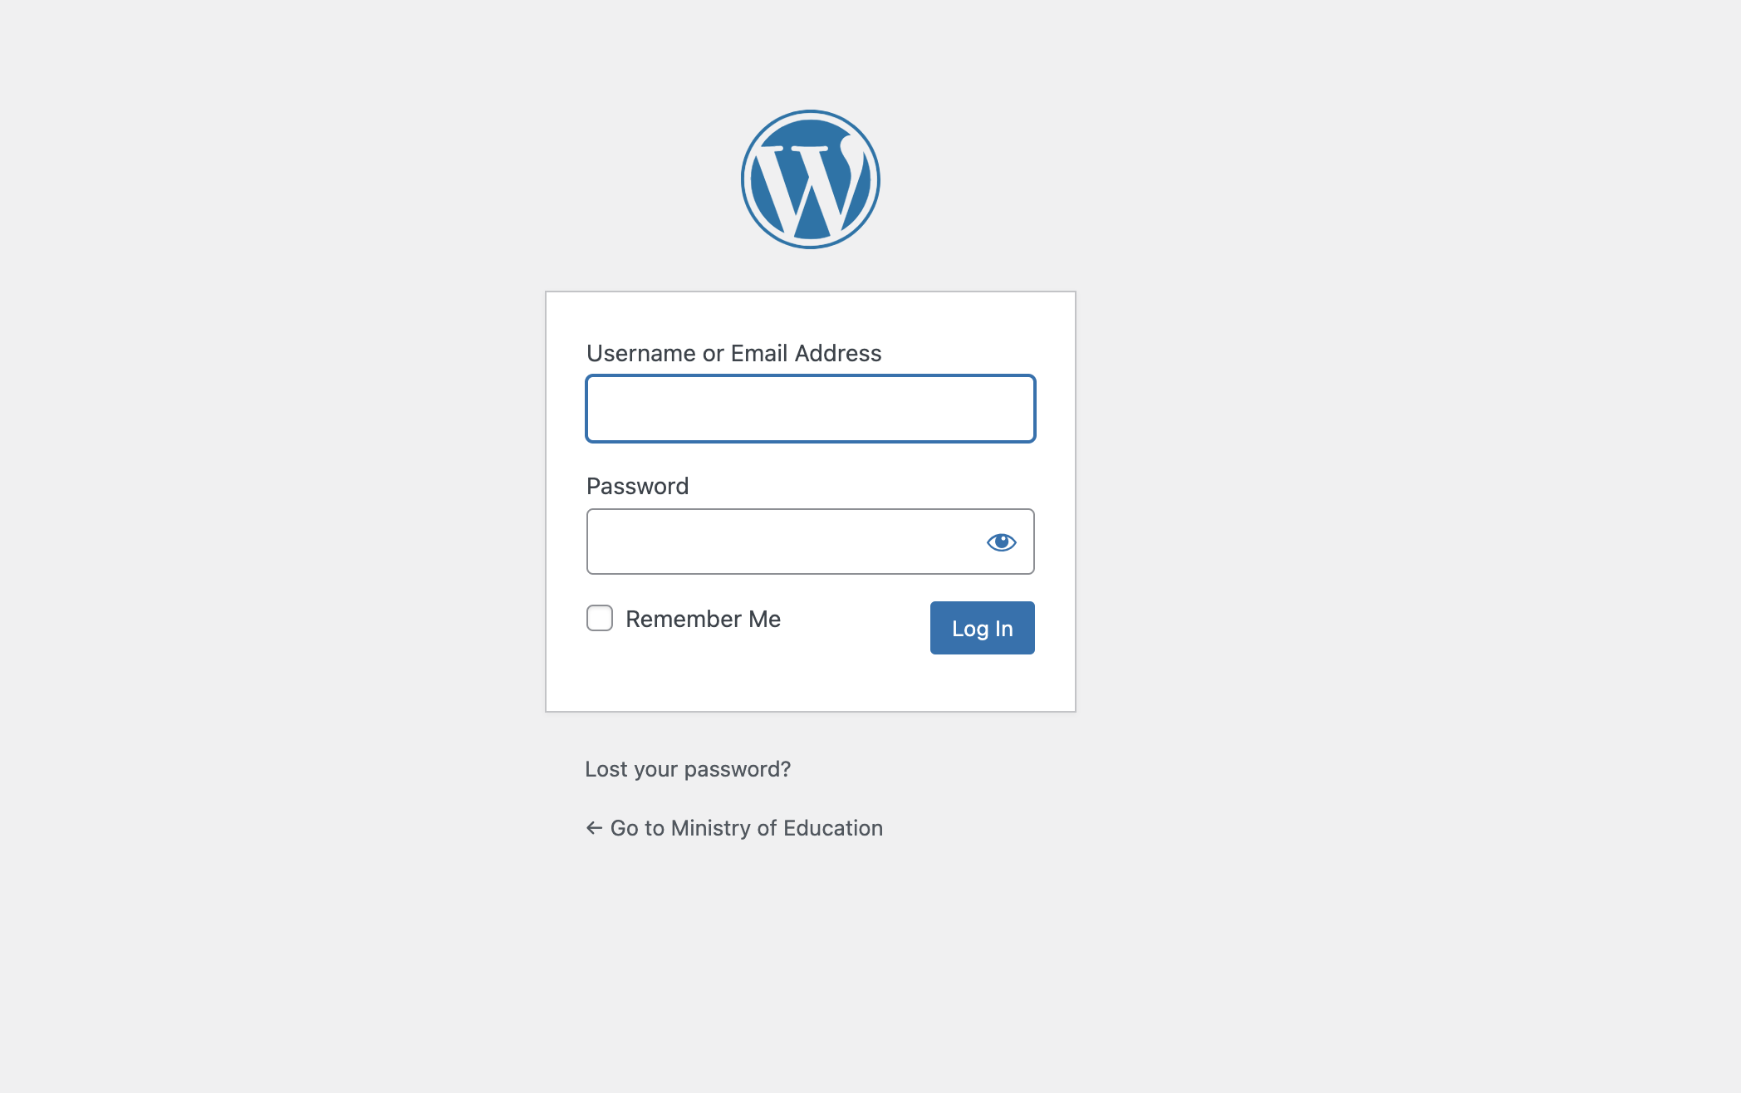
Admin Page
`
Link: https://naccaproject.gdatatalk.com/wp-admin/
Login with Username/Email and Password
See Login Page below

Slide 8
Uploading New File
`
Click Media on the left navigation bar.
Click “Add Media File”.
Click “Choose folder.”
Select a file.
See the Page below

Slide 9
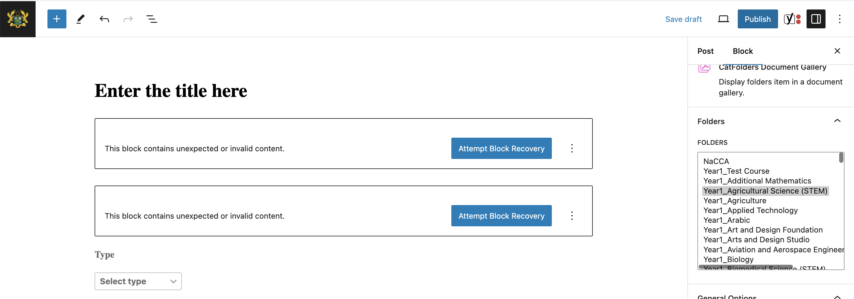
Publishing Updated File
`
Click “Posts” on the left navigation bar.
Click “Duplicate” by clicking Duplicate Existing Title
Click “Edit”. From the duplicated course
Click “Publish” after editing
See the Page below

Slide 10
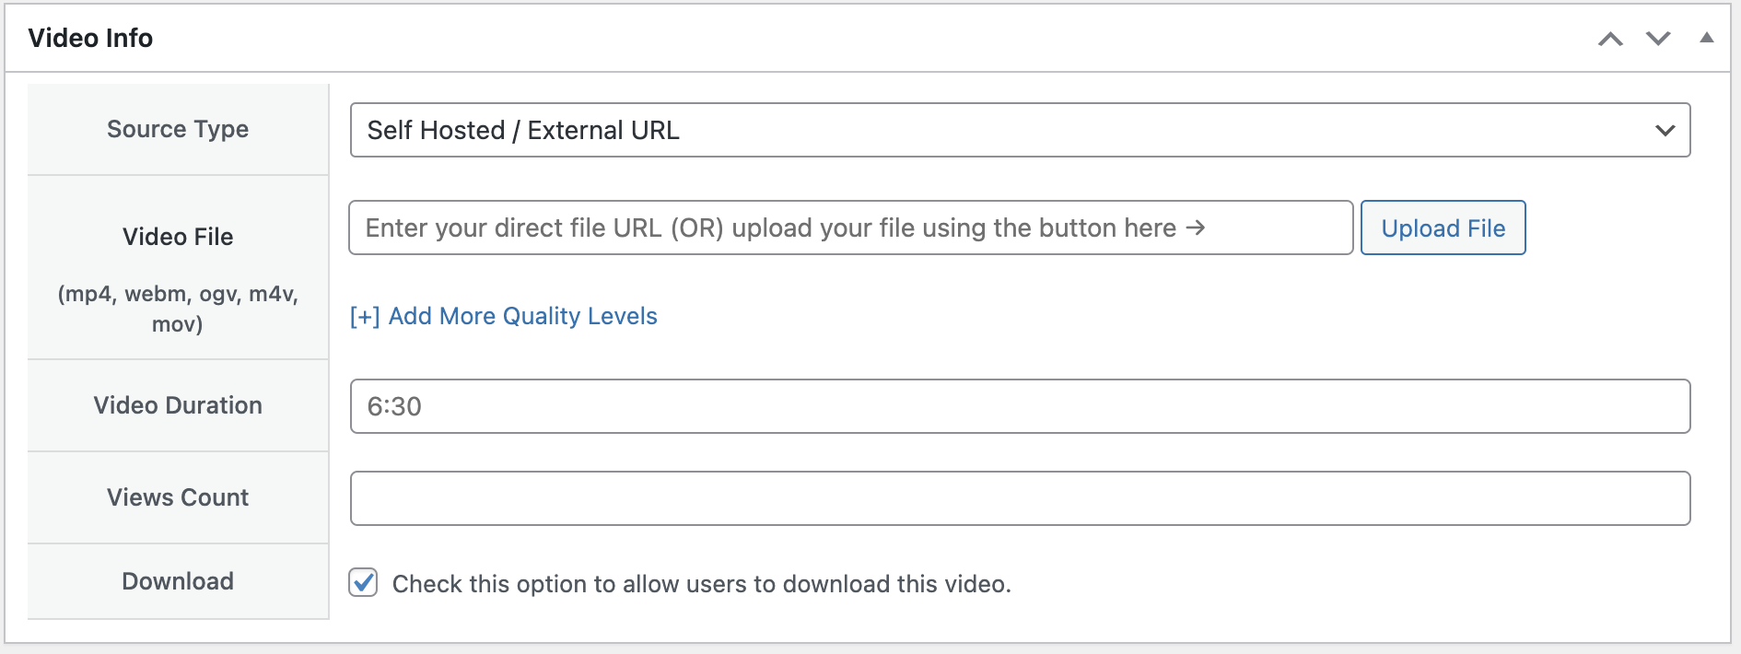
Uploading Video
`
Click “Video Gallery“ on the left navigation bar.
Click “Add New”.
Add Title
Select or add a video link to the form below.

Slide 11
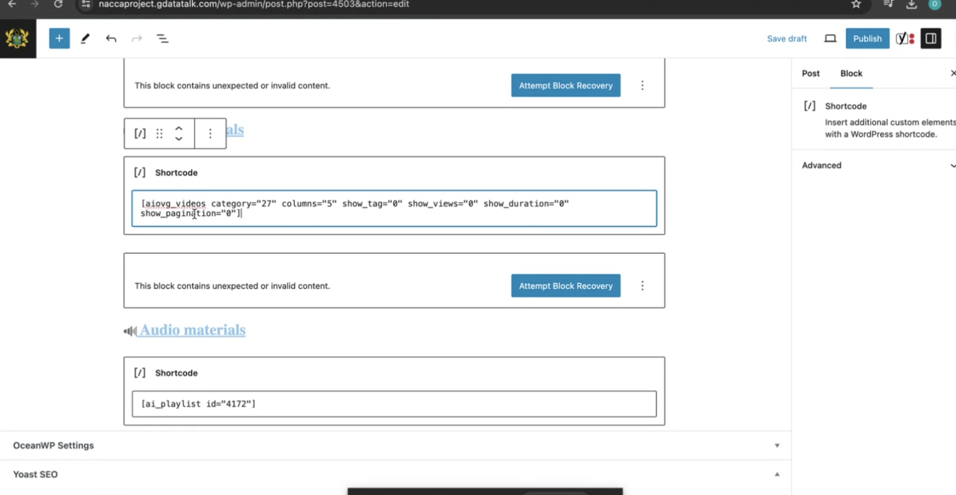
Uploading Video
`
Copy “Video Shortcode“.
Click “Post” and “Edit” on the title to add the video.
Paste the ”Short Code”
Select or add a video link to the form below.

Slide 12
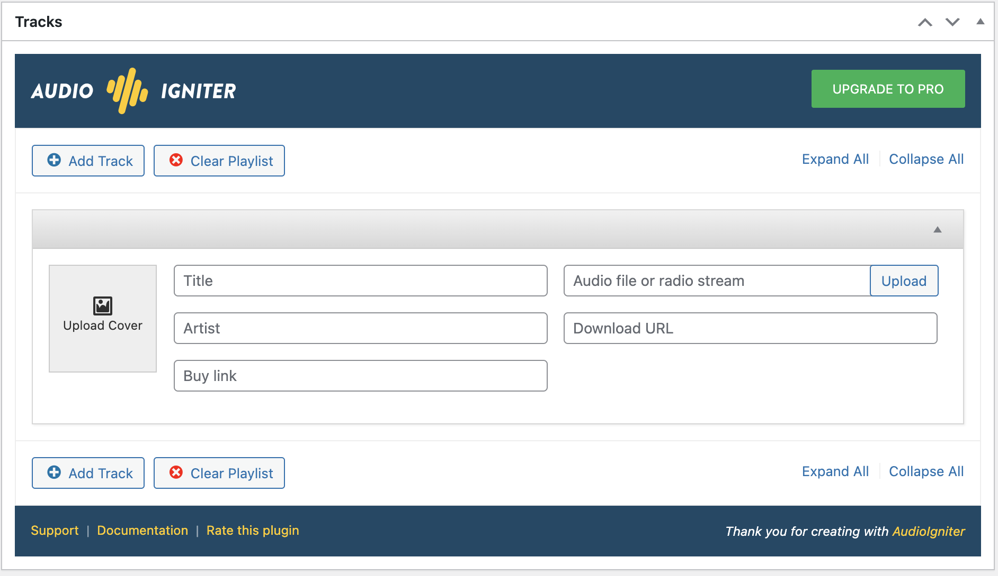
Uploading Audio
`
Click “AudioIgniter“.
Click ”Add New Playlist.”
Add Title
Select or add an Audio link to the form below.

Slide 13
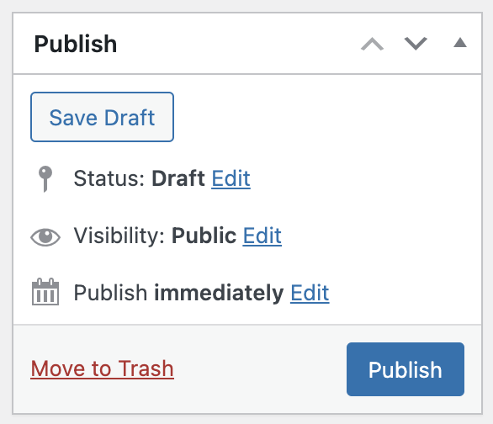
Uploading Audio
`
Copy Shortcode
Click “Post” and “Edit” on the title to add the audio.
Paste the ”Short Code”
Click “Publish“.
Publish an Audio link to the form below.

